Slide 1
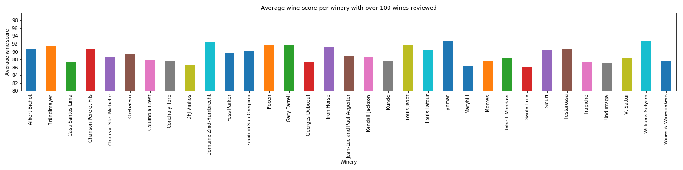
Wineries with the highest average wine score
The wineries with the highest average wine score are:
Domaine Zind-Humbrecht (France)
Lynmar (USA, California)
Williams Selyem (USA, California).
However these wineries have an average wine price in a diapason from 60 to 80$ per bottle. And it’s in the middle of a price range.

Slide 2
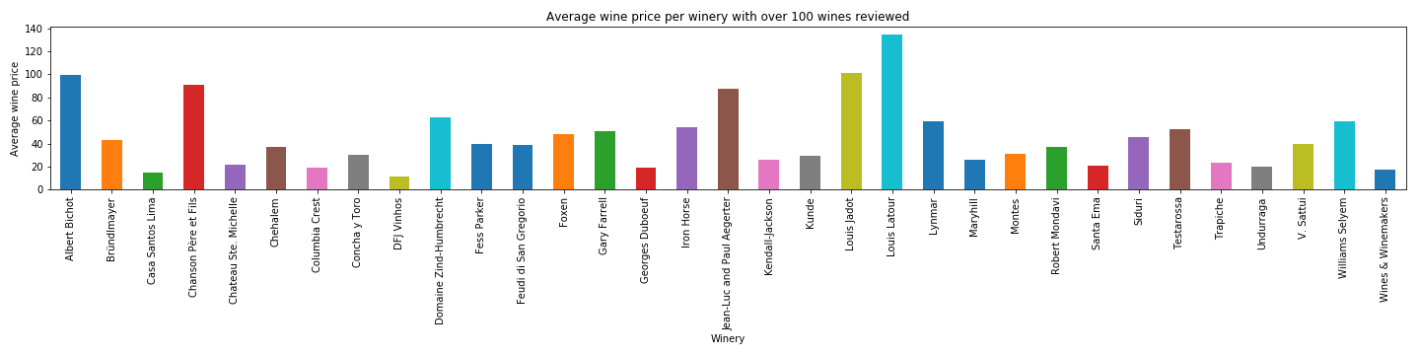
Wineries with the most expensive wines on average
Top 5 wineries with the highest average wine price are:
Louis Latour (France)
Louis Jabot (France)
Albert Bichot (France)
Chanson Pere et Fils (France)
Jean-Luc and Paul Aegerter (France)
And, surprisingly, they all are located in France.

Slide 3
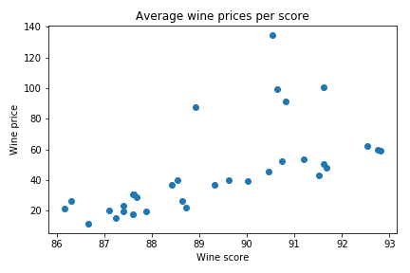
Correlation between a price and a score of a wine
While there is a clear trend: the higher an average price the higher a rating of a wine, it could be explained by subjective appreciation, it means people tend to rank higher more expensive wines. As the pleasure people get from consuming wine depends both on its intrinsic qualities such as taste and smell and external attributes such as price and presentation.

